Slide 1
UNEMPLOYMENT IN CZECHIA
Jiří Folwarczný, Nikol Masláková

Slide 2
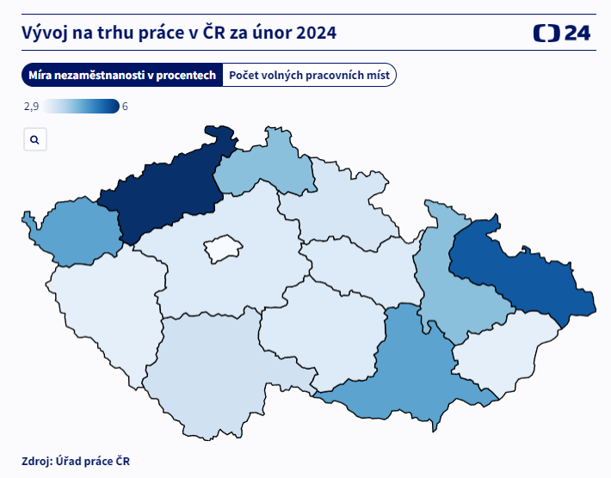
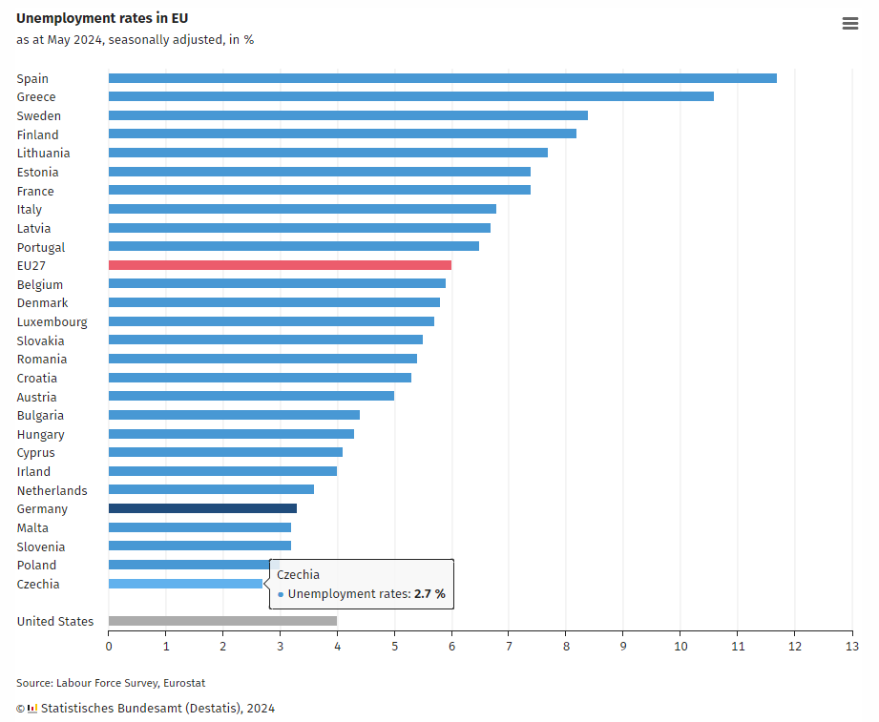
In general
Unemployment rate in percent
That’s us!
4,2
6
3,4
4,6
2,9
3,3
3,3
5,5
3,2
4,2
3,3
3,5
3,2
4,6

Slide 3
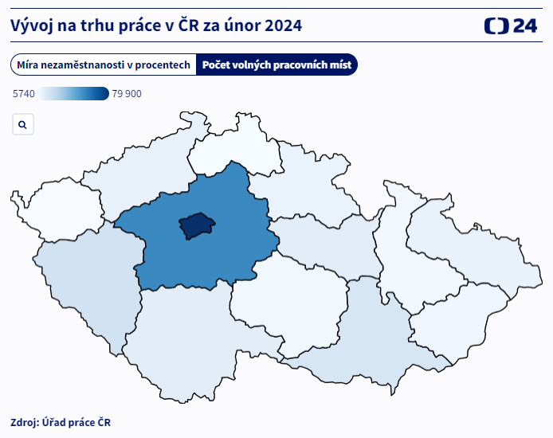
In general
Number of vacancies
11 271
5 740
79 900
10 856

Slide 4
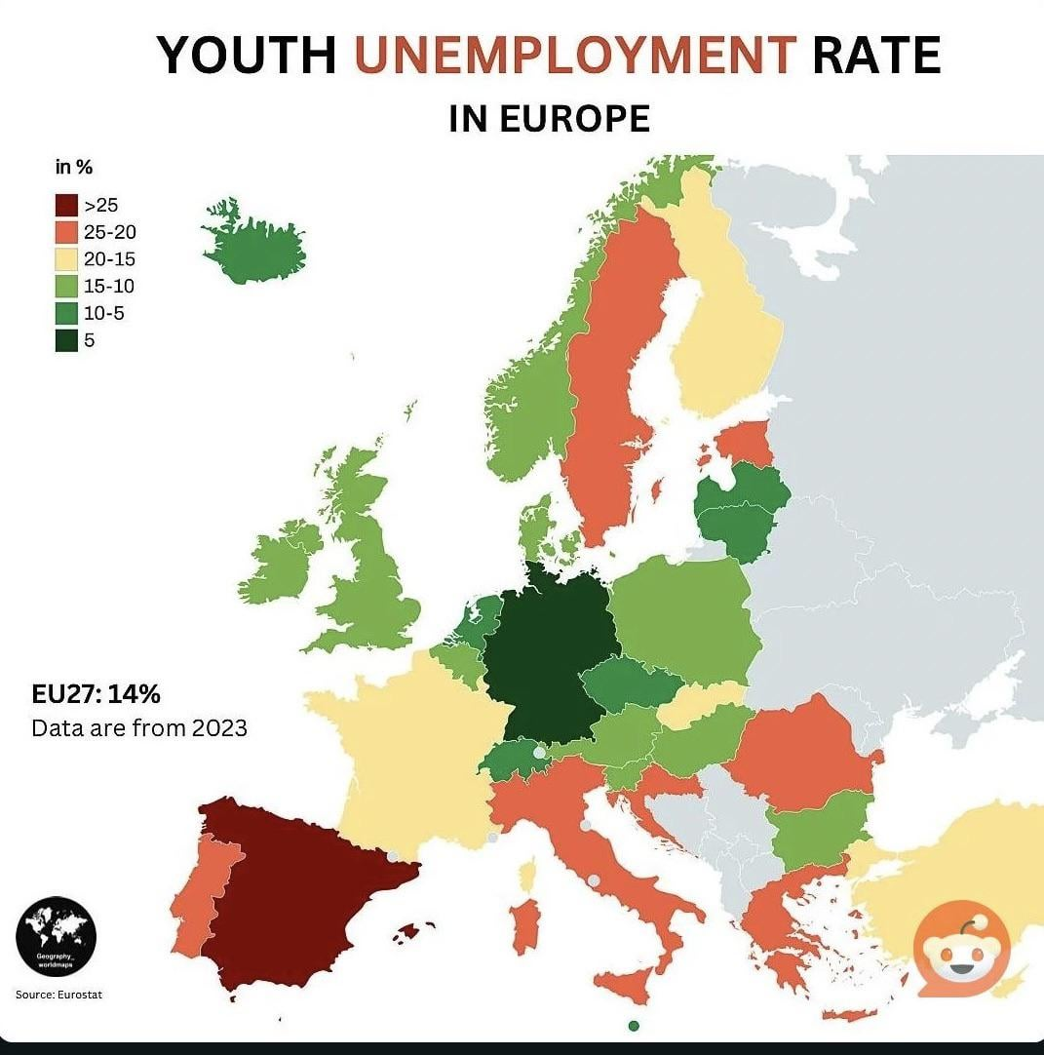
In general
Youth (15-24) unemployment rate in percent
17,6
8,4
17
27,9

Slide 5
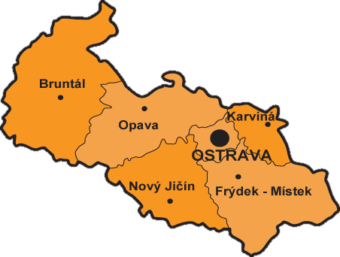
In our region
Unemployment rate in percent
3,22
7,39
The worst in the country (yaaay 🎉)
5,46
8,16
3,45
3,53

Slide 6

In our region
Liberty ostrava
Some industries (engineering, steel workers) are going into recession -> people lose jobs, retraining

